Slide 1
“Clients & patients
were treated as commodities
&
billing opportunities”
- Convicted Work Comp Attorney
“Insurance companies leave pallets
of hundred-dollar bills
out on the streets for us to scoop up”
- Professional Fraudster, fraud syndicate
Fraud Syndicates
Presenter:
Teena Barton, Major Case
Special Investigations Unit
ICW Group Insurance Company
C: 858.847.5883

Slide 5
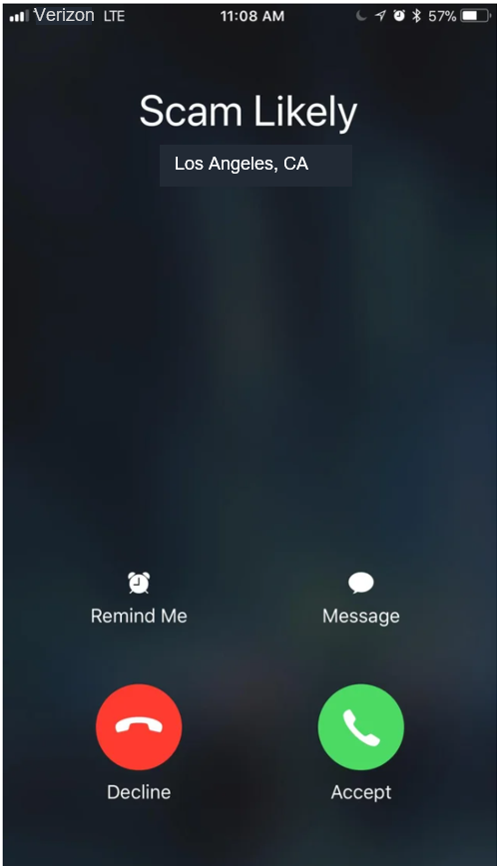
How did you find your attorney?
A. What attorney?

Slide 6
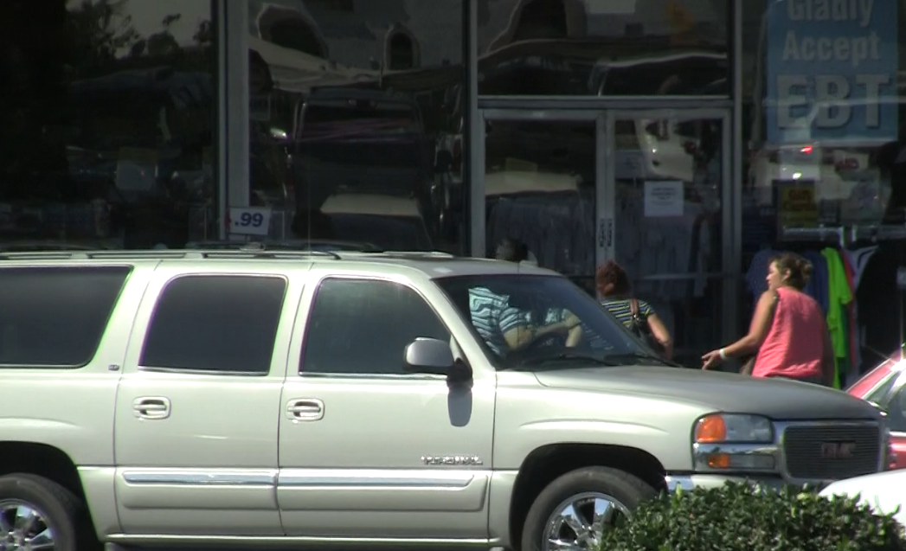
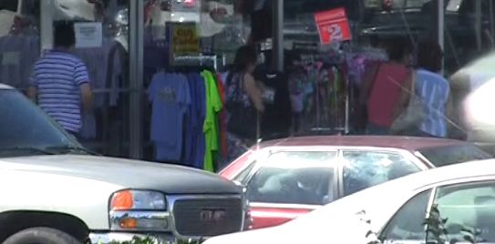
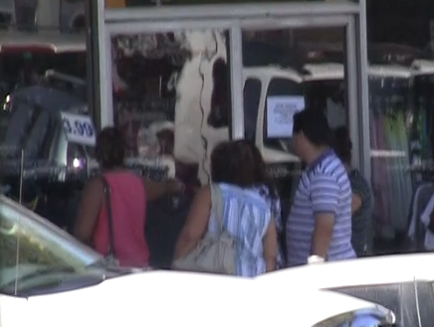
Live snapshots of street cappers acting like shoppers, scoping out a clothing factory for employees to sign up for work comp claims.

Slide 7
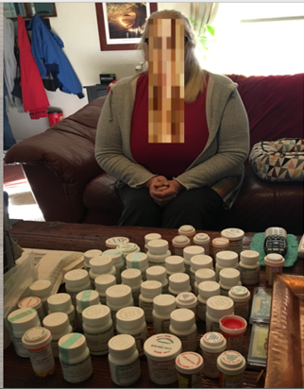

Slide 8
$
$
$ Chiro, Acupuncture
$
$ MD
$
$ Sleep Study, Psyche Evals
$ Labs
$
$ Physical Therapy
$ Ortho Evals
$
$ Rx
$
$ FCE
$ Billing & Collections
$ DME
$ Work Hardening, Voc Rehab
$
$ Transportation
$75,000
$ Interpreters
$ Copy Services
$
$ Legal Services
$
$ IME, AME, QME, IMR, IBR
$
$ Radiology

Slide 9
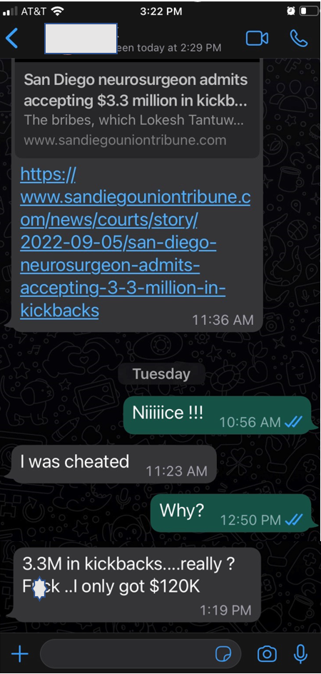

Slide 10
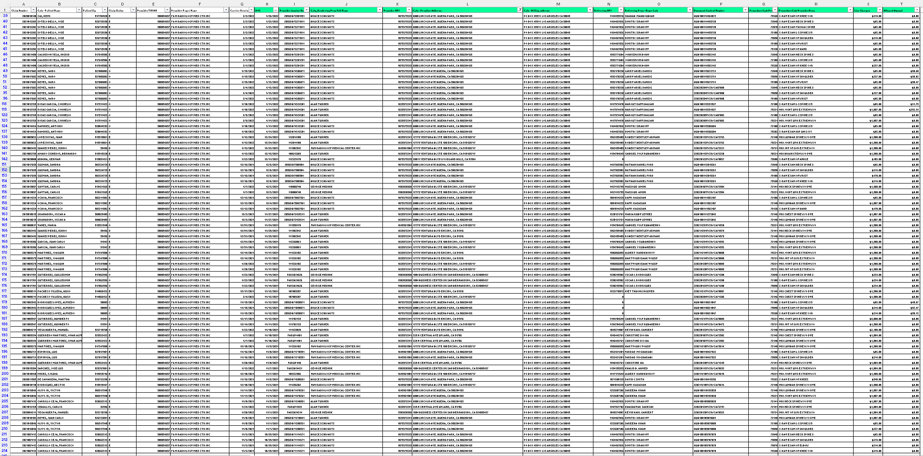

Slide 11
Billing opportunities
Control Point
Attorney Advertising
Call Center
Sign-Up Agent
Marketers (cappers)
Medical Scheduling
Doctors
Attorneys
Wash clean patients
Wash clean clients
“Go-Ready” Claimants + Claimant Personal Data
“Products & Services” geared for driving up claim volume, business referral volume & re-sale of claimant

Slide 12
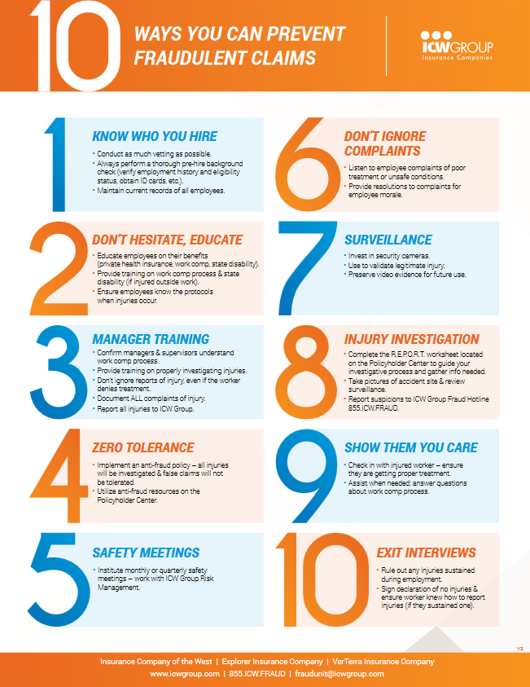

Slide 13
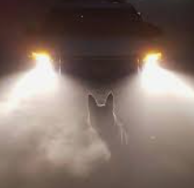
You have no enemies, you say?
Alas, my friend, the boast is poor.
He who has mingled in the fray of duty
that the brave endure,
must have made foes.
If you have none,
small is the work that you have done.
You’ve hit no traitor on the hip.
You’ve dashed no cup from the perjured lip.
You’ve never turned the wrong to right.
You’ve been a coward in the fight.
- Charles Mackay

Slide 14
Thank you!
Thank you!
Thank you!
Contact Info:
Teena Barton, SIU Investigator
ICW Group Insurance Co
858-847-5883

